Slide 1
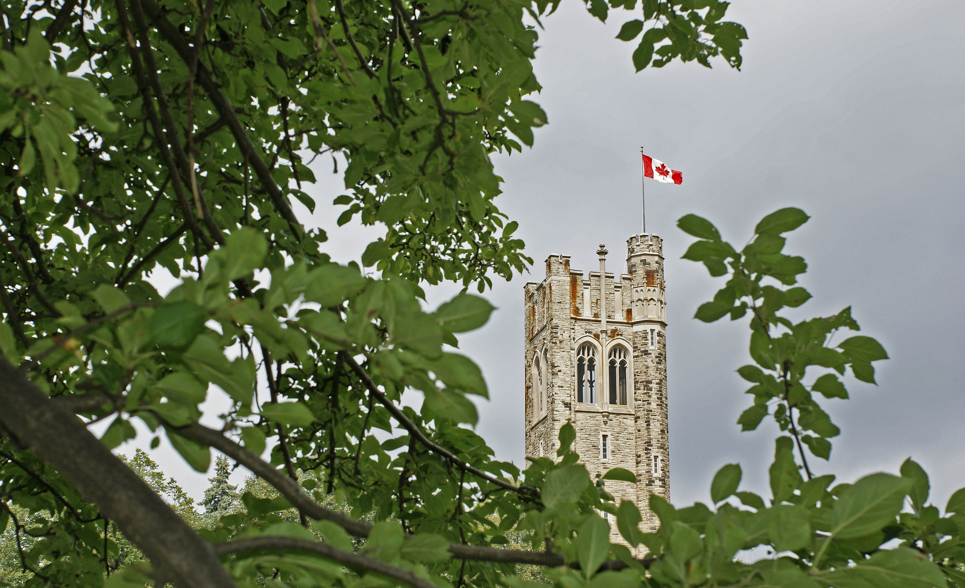
WESTERN UNIVERSITY
LONDON, CANADA

Slide 2
CONFERENCIA
DEMENTIA: ADVANCES IN PREVENTION
Vladimir Hachinski, CM, MD, FRCPC, DSc
Department of Clinical Neurological Sciences
Western University, London, Ontario, Canada

Slide 3
DEMENTIA: ADVANCES IN PREVENTION
I PERSPECTIVES
II ADVANCES
Population, Risk factors, Clinical, Genetics, Pathology, Pathophysiology
III CONCLUSIONS

Slide 4
NEUROLOGICAL DISORDERS: LEADING CAUSE OF DISABILITY ADJUSTED LIFE YEARS (DALY’S)
Approximately 10% of global DALY’s
Among neurological disorders
Stroke 42%
Dementia 10%
Estimates based on Global Burden of Diseases publications.
52%

Slide 5
STROKE AS A DEMENTIA RISK
12 studies of incident stroke
(1.3 million participants)
Hazards ratio 95% confidence P-value
interval:
2.18
1.90-2.50
0.00001
Kuzma E et al. Alz & Dement. 2018 (1-22)

Slide 6
5.5
5.0
4.5
3.5
Incidence per 1.000 Population
Dementia
Stroke
3.0
2.5
p-value for trend in stroke incidence < 0.001
p-value for trend in dementia incidence = 0.009 (Jonckheere-Terpstra Test)
2.0
2002
2003
2004
2005
2006
2007
2008
2009
2010
2011
2012
2013
Fiscal Year
Sposato LA…..Hachinski V. JAMA Neurol. 2015;72:1529-1531

Slide 7
DEMENTIA: ADVANCES IN PREVENTION
I PERSPECTIVES
II ADVANCES
Population, Risk factors, Clinical, Genetics, Pathology, Pathophysiology
III CONCLUSIONS

Slide 8
Main Proposed Risk & Protective Factors Common for Stroke & Dementia
Non-modifiable | Modifiable
Risk Factors | Risk Factors | Protective Factors
Advanced age | Cerebrovascular disease/stroke | High education
Genetic factors (ApoE4) | Cardiovascular disease | Physical activity
Family History | Hypertension | Antihypertensives
 | Hypercholesterolemia | Statins
 | Obesity | Active lifestyle
 | Diabetes | Mediterranean diet (added)
 | Smoking
 | Homocysteine
 | Stress
 | Depression
 | Atrial fibrillation (added) | Anticoagulation (added)
 | Air pollution (added) | Greening (added)
Modified from Solomon A…..Kivipelto M. et al. JIM 2014

Slide 9
90·5% of the Stroke Burden (as measured in DALYs) is Attributable to The Modifiable Risk Factors
Behavioral factors | Clusters of metabolic factors | environmental factors
74·2% (95% UI 70·7–76·7) | 72·4% (95% UI 70·2–73·5) | 33·4% ( 95% UI 32·4–34·3)
Smoking | High Systolic BP | Air pollution
Low physical activity | High BMI | Lead exposure
Poor diet | High fasting plasma glucose
 | High total cholesterol
 | Low glomerular filtration rate
Feigin VL et al. Lancet Neurol. 2016;15:913-924

Slide 10
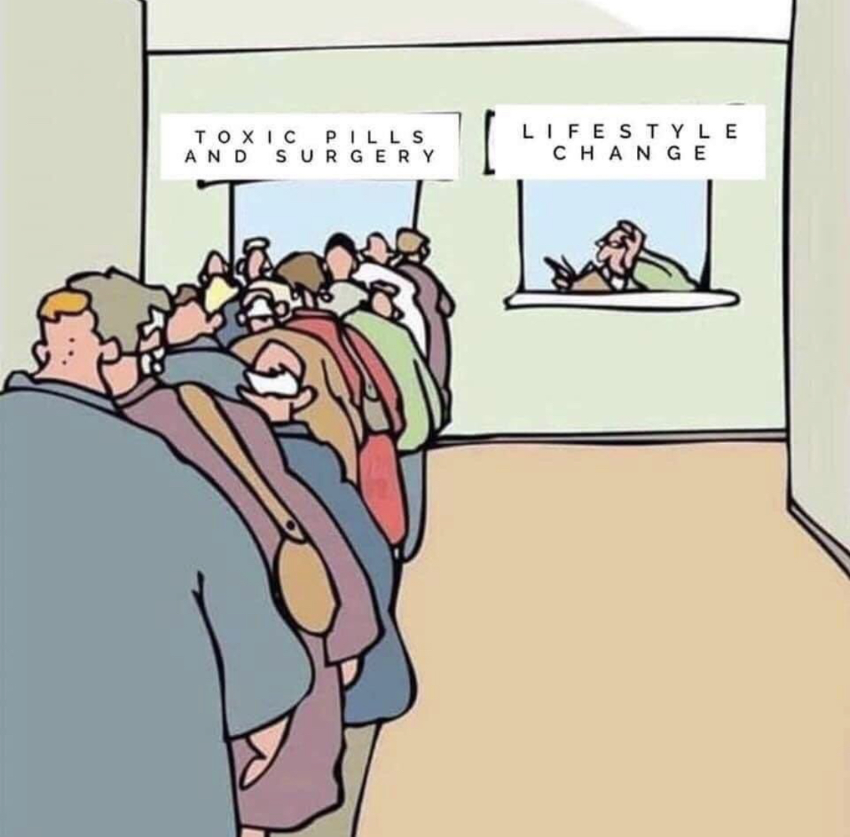

Slide 11
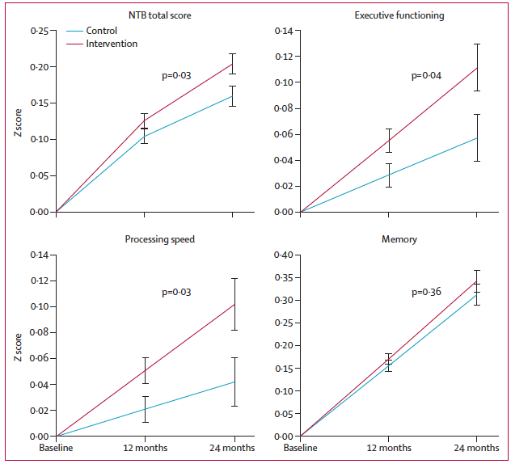
Finger Trial
University of Eastern Finland & Karolinska Institute+-Stockholm University
Multi-domain Intervention can Prevent Cognitive Decline in at-risk Elderly People
Double-blind randomised controlled trial
Study cohort: 1,260 subjects, 60-77 years-old, with CAIDE
Treatment arms: diet + exercise cognitive training + vascular risk factors monitoring vs. general health advice
Outcome: Change in cognition at 2 years
OR 1.31
(1.01-1.71)
OR 1·29
(1·02-1·64)
OR 1.35
(1·06-1·71)
OR 1.23
(0·95-1·60)
Ngandu T et al. The Lancet 2015;385:2255-2263

Slide 12
ATRIAL FIBRILLATION, ANTICOAGULATION AND DEMENTIA
Swedish Patient Register and Dispensed Drug Register
Retrospective Cohort Study
N = 444, 106 2006-2014
26,210 developed dementia
Propensity matching
↓48% dementia in treated group
(HR 0.52, 95% CI 0.50-0.55)
No difference between Warfarin and new oral anticoagulants.
Friberg & Rosenquist
European Heart. 2018;39:453-460

Slide 13
ApoƐ4 BLOOD FLOW AND WHITE MATTER DAMAGE
ApoƐ4 mice ↓ vascular density
→↓ cerebral blood flow
Compared to ApoƐ4 mice
Hypotension
ApoƐ4 mice hypoxia, corpus callosum damage and ↓ cognitive function
Koizumi K…Iadecola C. Nature Comm. 2018.9:3816

Slide 14
Systemic coordination between angiogenesis and neurogenesis. Neuronal cells express VEGF that induces proliferation of endothelial cells through its receptors, VEGFR and/or NRP
Park JA, et al. Biochem Biophys Res Comm. 2016;311:247-253

Slide 15
DEMENTIA: ADVANCES IN PREVENTION
I PERSPECTIVES
II ADVANCES
Population, Risk factors, Clinical, Genetics, Pathology, Pathophysiology
III CONCLUSIONS

Slide 16
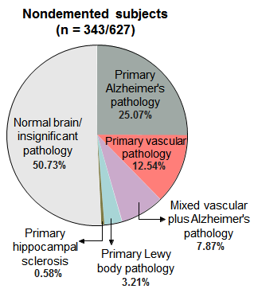
DISTRIBUTION OF PRIMARY NEUROPATHOLOGIES
Azarpazhooh R…Hachinski V. Distribution of Primary neuropathologies according to three population-based studies: 90+ study 2015, Honolulu Asia Aging Study 2009 and Arizona Study of Aging and Neurodegenerative Disorders. (Alz & Dem. 2018;14:148-156)

Slide 17
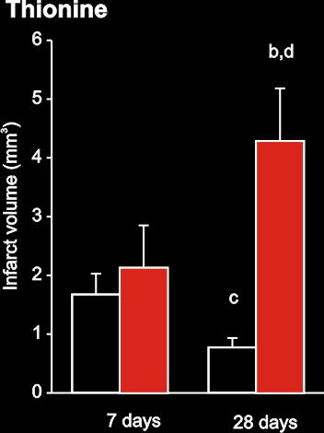
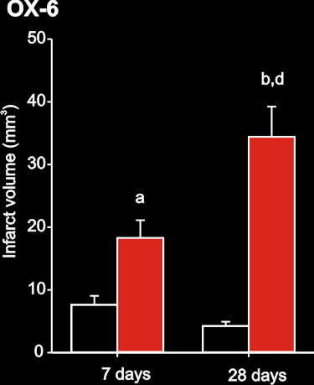
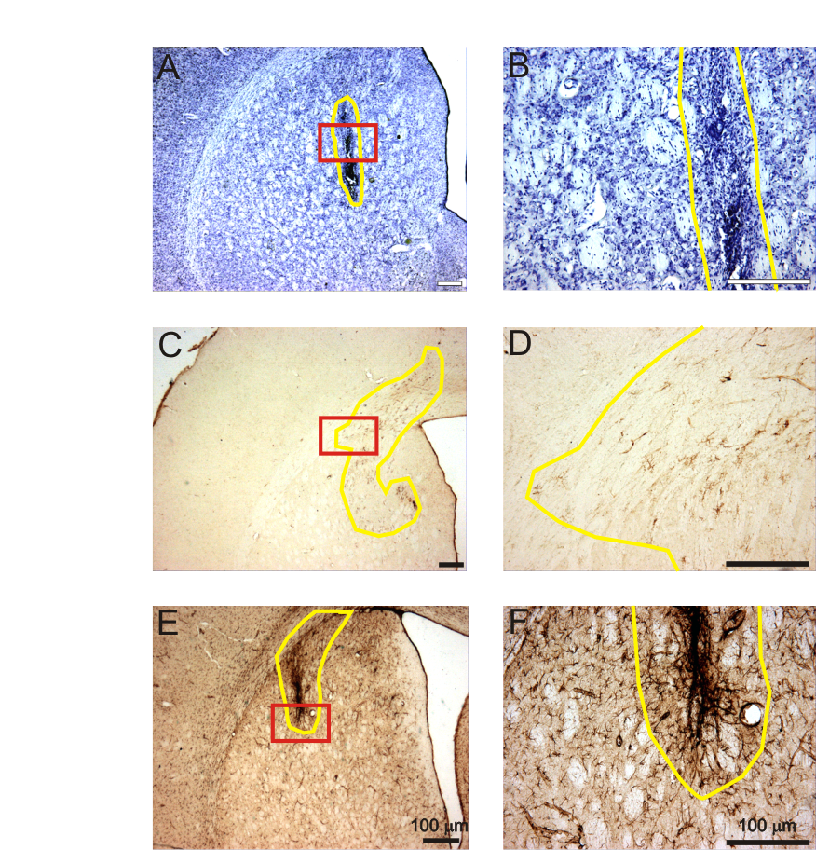
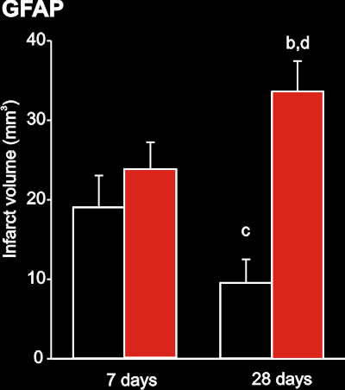
Synergistic effect on infarct growth
S.N. Whitehead, G. Cheng, et al., Stroke 2007.

Slide 18
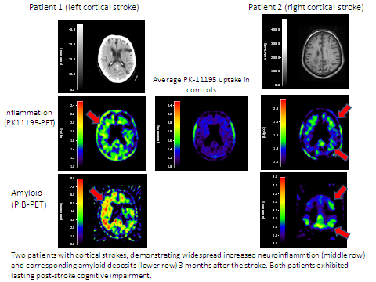

Slide 19
SPRINT MIND STUDY
9,361 subjects at risk of vascular disease randomized to
1. Target systolic BP 140 mmHg
2. Target systolic BP 120 mmHg
A 3.26 year median follow-up study stopped (120 mmHg target resulted in better outcomes) but cognitive assessments continued for additional 3 years

Slide 20
SPRINT MIND STUDY CONT’D
RESULTS:
Hazards Ratio Significance*
1. Incident probable dementia 0.83 95% CI 0.67-1.04 p=0.10
2. Mild cognitive impairment 0.81 95% CI 0.70-0.95 p=0.001
3. Combined 1 and 2 outcome 0.85 95% CI 0.74-0.97 p=-0.02
The SPRINT MIND investigators for the SPRINT Research Group. JAMA 2019;321:553-561

Slide 21
DEMENTIA: ADVANCES IN PREVENTION
I PERSPECTIVES
II ADVANCES
Population, Risk factors, Clinical Genetics, Pathology Pathophysiology
III CONCLUSIONS

Slide 22
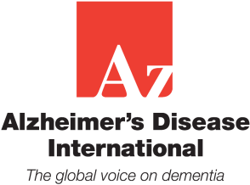
Stroke and Potentially Preventable Dementias Proclamation
Updated World Stroke Day Proclamation
Vladimir Hachinski, MD, DSc; on behalf
of the World Stroke Organization
Stroke 2015;46 and International Journal of Stroke 2015;

Slide 23
Special Topic Section: Linkages Among Cerebrovascular, Cardiovascular, and Cognitive Disorders
Preventing dementia by preventing stroke:
The Berlin Manifesto
Vladimir Hachinski, Karl Einhäupl, Detlev Ganten, Suvarna Alladi, Carol Brayne, Blossom C. M. Stephan, Melanie D. Sweeney, Berislav Zlokovic, Yasser Iturria-Medina, Costantino Iadecola, Nozomi Nishimura, Chris B. Schaffer, Shawn N. Whitehead, Sandra E. Black, Leif Østergaard, Joanna Wardlaw, Steven Greenberg, Leif Friberg, Bo Norrving, Brian Rowe, Yves Joanette, Werner Hacke, Lewis Kuller, Martin Dichgans, Matthias Endres, Zaven S. Khachaturian
Alzheimer's & Dementia. 2019. 15:961-984

Slide 24
STROKE AS A DEMENTIA RISK
12 studies of incident stroke
(1.3 million participants)
Hazards ratio 95% confidence P-value
interval:
2.18
1.90-2.50
0.00001
Kuzma E et al. Alz & Dement. 2018 (1-22)

Slide 25
5.5
5.0
4.5
3.5
Incidence per 1.000 Population
Dementia
Stroke
3.0
2.5
p-value for trend in stroke incidence < 0.001
p-value for trend in dementia incidence = 0.009 (Jonckheere-Terpstra Test)
2.0
2002
2003
2004
2005
2006
2007
2008
2009
2010
2011
2012
2013
Fiscal Year
Sposato LA…..Hachinski V. JAMA Neurol. 2015;72:1529-1531

Slide 27
THE DEMENTIA PREVENTION INITIATIVE
I MAPPING & MODELING
Mapping the spatial and temporal distribution and inequalities in incidence/prevalence in dementia and stroke across Canada and in more detail in Southwestern Ontario

Slide 28
THE DEMENTIA PREVENTOIN INITIATIVE: A SYSTEMS SCIENCE APPROACH
II MODIFY & DEVELOP TOOLS TO IDENTIFY HIGH RISK POPULATIONS
1. Cambridge cognitive assessment battery
2. Ischemic score

Slide 29
ISCHEMIC SCORE WITH 5 COMPOSITE ITEMS*
Item No. | Item Description | Score if Answer is Yes
1 / 2 | Abrupt onset or stepwise deterioration | Scored electronically
3 / 4 | Fluctuating course or nocturnal confusion | Scored electronically
6/8 | Depression or emotional incontinence | Scored electronically
9/11 | History of hypertension or atherosclerosis | Scored electronically
10/12 | History of stroke or focal neurological symptoms | Scored electronically
Total |  | Scored electronically
* A vascular component of cognitive impairment may be indicated after electronic computation
Hachinski V. et al Arch Neurol 2012:69(2):169-175

Slide 30
THE CANADIAN POPULATION PREVENTION OF DEMENTIA INITIATIVE: A SYSTEMS SCIENCE APPROACH
III TRAINING A NEW TYPE OF HEALTH PROFESSIONAL IN THE JOINT PREVENTION OF DEMENTIA & STROKE
1. Fellowship in the joint prevention of dementia and stroke
2. Development of “in situ” and online modules
3. Modification and adaptation of proven strategies to undertake and enhance adherence to healthy behaviors

Slide 31
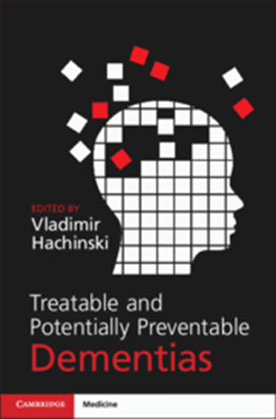

Slide 32
HENRY STEWART TALKS

Slide 33
ACKNOWLEDGEMENTS
THE TEAM
Mapping & Modeling Identifying Populations at Risk
Reza Azarpazhooh/Moira Kapral Adrian Owen/Vladimir Hachinski
Ehsan Abolhasani, MSc candidate Saverio Stranges
Shehzad Ali
Robert Andersen Training
David Armstrong Reza Azarpazhooh/Kem Rogers
Mark Daley Victoria Esses
Jason Gilliland Lauren Mai
Soushyant Kiarisi, MSc candidate Christopher Watling
Janet Martin
Salimah Shariff TranslationaL
Saverio Stranges Nicole Farrell, MBA candidate
Juan Camilo Vargas, PhD candidate Janet Martin
Piotr Wilk Matthew Meyer
Patrice Lindsay – Heart & Stroke Foundation of Canada Saskia Sivananthan – Alzheimer Society
Ross Tsuyuki – Hypertension Canada

Slide 34
CONCLUSIONS
1. Alzheimer disease of old age is not a disease but a syndrome
2. Growing evidence that we can decrease dementia risk
3. Preventing stroke is the most tangible way of preventing some dementias

